Slide 1
Social evils
Presented by
Muhammad Jahanzaib
Muhammad Hamza Yousaf

Slide 2
What are social evils?
Social means interaction of people of society and effects of their doings and behavior on the society overall
An evil is usually referred to something troublesome and harmful.
Social evils are destructive to the peace and harmony of a country as a whole

Slide 3
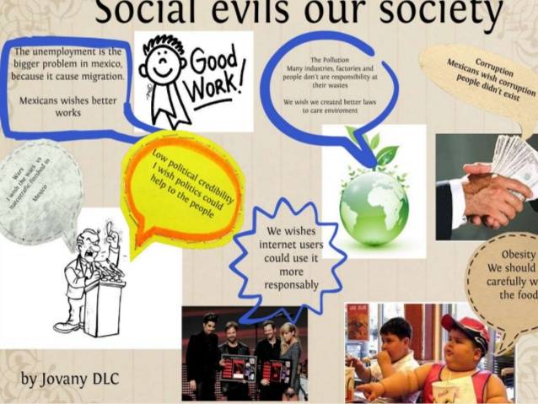
Types of Social evils in society
Corruption
Drug Addiction
Child Labour
Terrorism
Road Accidents

Slide 4

Corruption in Pakistan

Slide 5
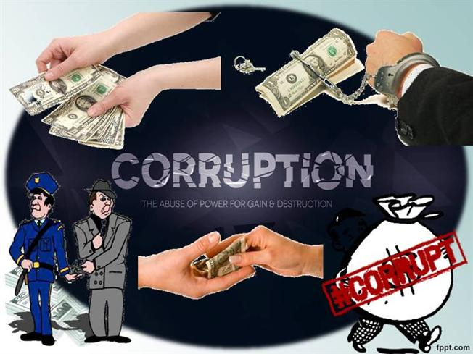
What is corruption?
Corruption is a term with many meanings, but generally it entails misusing ones office for a private gain unofficial end . It involves both monetary and non-monetary benefit.

Slide 6
Types of corruption
Political Corruption.
Corrupt Judicial system
Corrupt educational system
Law enforcement and police

Slide 7

Drugs
What they are and what they do?
A drug, is a substance when absorbed into the body of a living organism, alerts normal bodily function physical as well as emotionally.

Slide 8
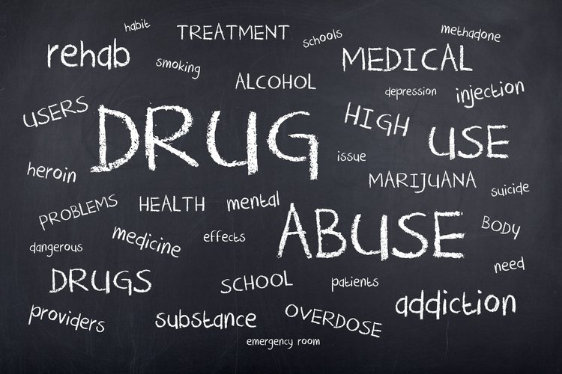
Causes of Drug addiction
Poverty
Unemployment
Domestic issues
Lack of education
Easy access to drugs
Stress , Anxiety , Depression

Slide 9
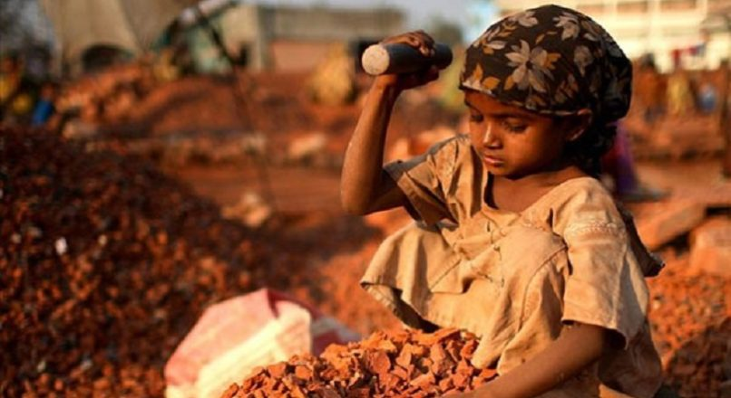
Child Labour
Many a time poverty forces parents to send their children to hazardous jobs. Although they know it is wrong they have no other alternative as they need Money for very basic needs of life i.e Food or medicine etc.

Slide 10
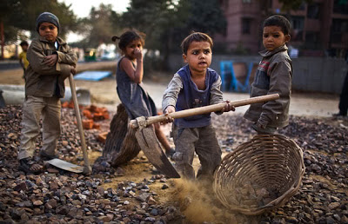
Causes of child labour....
Poverty
Potential illiteracy
Absence of compulsory primary education
Social empathy and tolerance of child labour
Tradition of making children learn the family skills
Ignorance of the parents about the adverse consequences of child labour

Slide 11
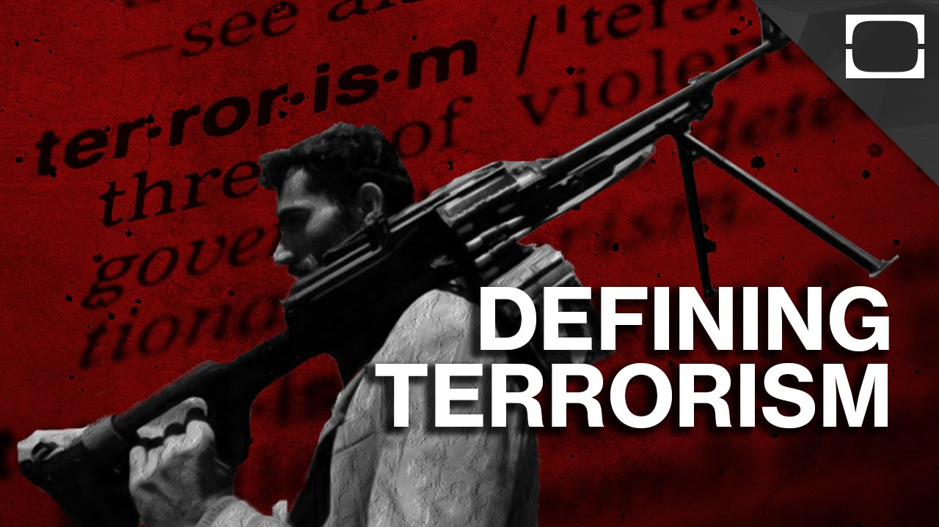
Terrorism
Terrorism comes from a Latin word “Fear”. The unlawful and criminal use of force against Persons or Property to intimidate or coerce the Government, Civilian Population, or its segments. It may be with criminal, political or social objectives.

Slide 12
CAUSES OF TERRORISM
Political Causes
Socio-Economic causes
Non Democratic setup Improper Government setup Absence of Law
Injustice Illiteracy Poverty and unemployment Food insecurity Dissatisfaction
External Causes
Religious Causes
Afghan war 1979 Iranian revolution
Role of Madrasahs Religious intolerance

Slide 13
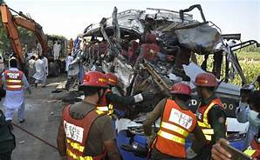
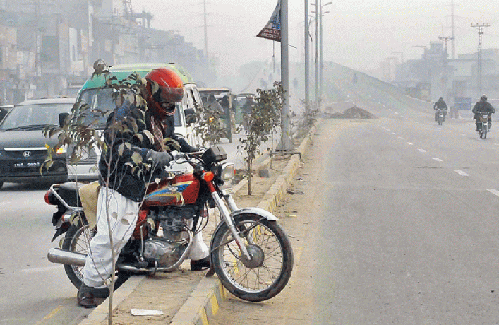
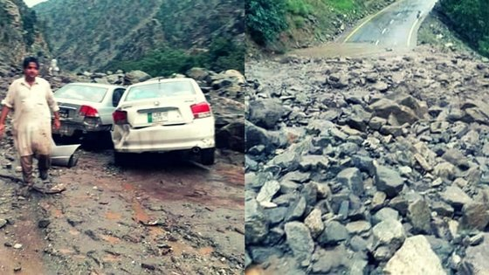
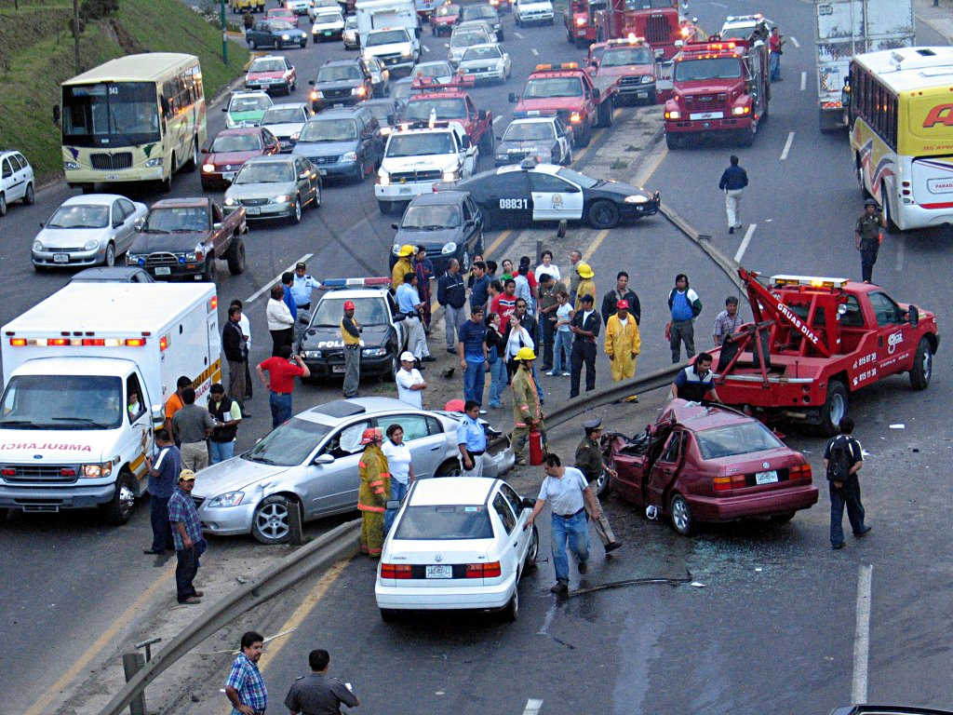
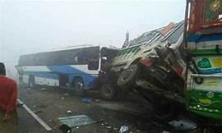
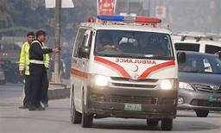
Road Accidents
Due to traffic rules violation

Slide 14


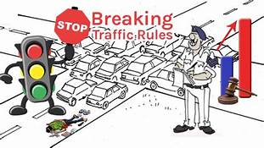
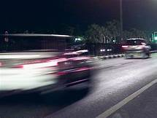
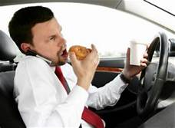
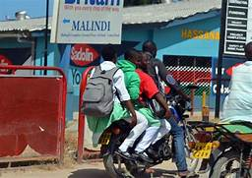

Major Causes of Road Accidents

Slide 15


Slide 16


Steps To Get Rid of Corruption
Anti Corruption, Police & Courts
Proper Salary & Benefits
Media & Religious Scholars
Awareness about corruption to people of society

Slide 17



Steps to recover from drug addiction
Eat Healthy
Take Exercises
Take a Trip
Avoid Bad Company
Manage Debt if Any
Consult to Rehab Centeres
Consult to religious scholar for internal peace

Slide 18

Stop Child Labour
Educate and Empower Them
Steps to Stop Child Labour
Establish Strict laws to protect children's rights.
More employments so parents never send their children's to earn Money.
Try to help poor people around you and also establish NGOs for helping poor people on national and international level.

Slide 19

How To Stop Terrorism?
Provide basic education to every person.
If the feeling of the injustice is unjustified it can be removed.
By changing policies against militants.
Attack terrorist and their capacity to operate.
Take strict actions about Terrorists and Extremists online activities.

Slide 20
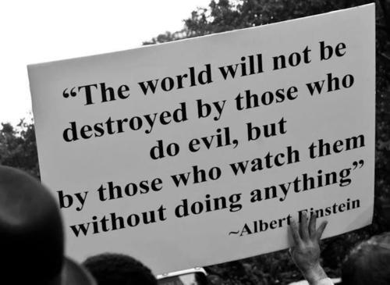

Slide 21
Thank You…

